Slide 1
Review
DBS201

Slide 2
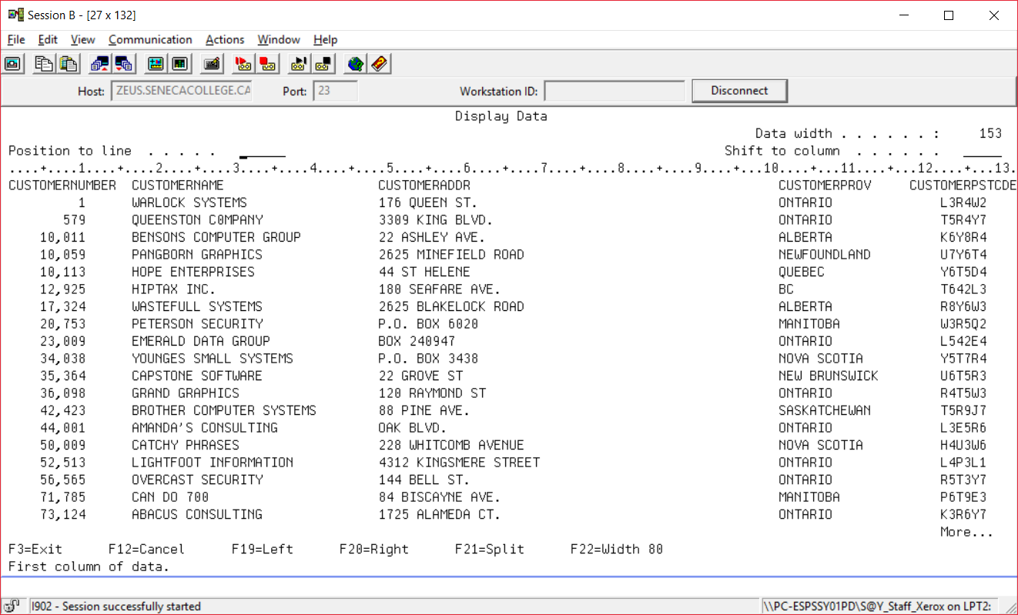
CUSTOMER17

Slide 3
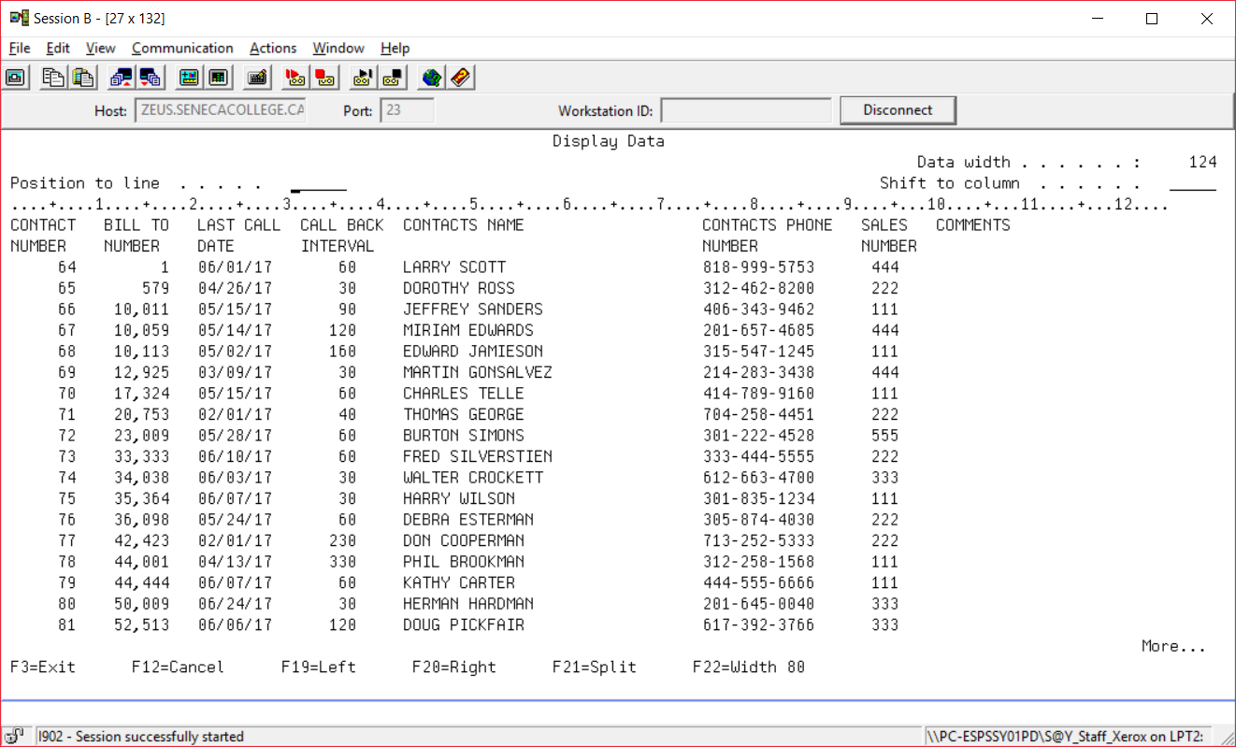
CONTACTF17

Slide 4
SQL REVIEW – using handouts

Slide 5
ERD

Slide 6
ERD Associative Entity

Slide 7
What is Normalization?
Normalization is a series of steps used to evaluate and modify table structures to ensure that every non-key column in every table is directly dependent on the primary key.
The results of normalization are reduced redundancies, fewer anomalies and improved efficiencies.

Slide 8
First Normal Form (1NF)
1
2
3

Slide 9
Second Normal Form (2NF)
1
2

Slide 10
Third Normal Form (3NF)
1
2

Slide 11
USERVIEW 1 SENECA SHEAR SALON SERVICE CHARGE LIST
:
SERVICE CODE | SERVICE DESCRIPTION | STATION CODE | CHARGE | TIME ESTIMATE (min)
10 | Cut | H | 10.00 | 30
11 | Cut and Blow-Dry | H | 15.00 | 45
12 | Perm | H | 30.00 | 60
13 | Highlights | H | 25.00 | 60
20 | Manicure | E | 10.00 | 30
21 | Pedicure | E | 15.00 | 30
23 | Hand and Foot Massage | M | 15.00 | 30
24 | Back Massage | M | 20.00 | 45
UNF,1NF,2NF,3NF:
Sevrice_Charge_List( ServiceCode, ServiceDesc, StationCode, Charge, Duration)

Slide 12

User View 2:
SENECA SHEAR SALON INVOICE
DATE: Jul 31 2013 CLIENT: Paul INVOICE#: 1423
HAIR: Cindy, 120 ESTHETICS: MASSAGE:
SERVICE CHARGE
10 – Cut 10.00
SERVICE SUBTOTAL 10.00
PRODUCT# AND NAME QTY CHARGE
144 Raymond Styling Gel 2 12.00
235 Style Volumizing Shampoo 1 8.00
PRODUCT SUBTOTAL: 20.00
INVOICE SUBTOTAL: 30.00
PST: 2.40
GST: 2.10
INVOICE TOTAL: 34.50
PREPARED BY: Paula Corelli, #121

Slide 13

SENECA SHEAR SALON INVOICE
DATE: Aug 1, 2013 CLIENT: Mary INVOICE#: 1425
HAIR: Anna, 135 ESTHETICS: Rachel, 133 MASSAGE:
SERVICE CHARGE
12 - Perm 30.00
20 - Manicure 10.00
21 - Pedicure 15.00
SERVICE SUBTOTAL 55.00
PRODUCT# AND NAME QTY CHARGE
234 Style Volumizing Shampoo 1 5.00
PRODUCT SUBTOTAL: 5.00
INVOICE SUBTOTAL: 60.00
PST: 4.80
GST: 4.20
INVOICE TOTAL: 69.00
PREPARED BY: Amy Smith, #136

Slide 14
Userview 2
UNF:
INVOICE(Invoice#, ClientName, InvDate, HairEmpNo, HEmpFName, EsthEmpNo, EsthEmpFName, MassEmpNo, MassEmpFName, { ServiceCode, ServiceDesc, Charge}, ServiceSubTotal, { Product#, ProductName, ProductQty, ProductCharge}, ProductSubTotal, PstAmt, GstAmt, PrepEmpNo, PremEmpFName, PrepEmpLName)
1NF:
INVOICE(Invoice#, ClientName, InvDate, HairEmpNo, HEmpFName, EsthEmpNo, EsthEmpFName, MassEmpNo, MassEmpFName, ServiceSubTotal, ProductSubTotal, PstAmt, GstAmt, InvoiceTotal, PrepEmpNo, PreepEmpFName, PrepEmpLName)
INVOICED_SERVICE(Invoice# FK1, ServiceCode FK2, ServiceDesc, Charge)
INVOICED_PRODUCT(Invoice# FK1, Product# FK2, ProductName, ProductQty,ProductCharge)

Slide 15
Userview 2
2NF:
INVOICE(Invoice#, ClientName, InvDate, HairEmpNo, HEmpFName, EsthEmpNo, EsthEmpFName, MassEmpNo, MassEmpFName, ServiceSubTotal, ProductSubTotal, PstAmt, GstAmt, InvoiceTotal, PrepEmpNo, PreepEmpFName, PrepEmpLName)
SERVICE(ServiceCode, ServiceDesc, Charge)
INVOICED_SERVICE(Invoice# FK1,ServiceCode FK2)
PRODUCT(Product#, ProductName)
INVOICED_PRODUCT(Invoice# FK1,Product# FK2, ProductQty,ProductCharge)
3NF
INVOICE(Invoice#, ClientName, InvDate, HairEmpNo, EsthEmpNo, , MassEmpNo, ServiceSubTotal, ProductSubTotal, PstAmt, GstAmt, InvoiceTotal, PrepEmpNo)
EMPLOYEE(EmpNo, EmpFName, EmpLName)
SERVICE(ServiceCode, ServiceDesc, Charge)
INVOICED_SERVICE(Invoice# FK1, ServiceCode FK2 )
PRODUCT(Product#, ProductName)
INVOICED_PRODUCT(Invoice# FK1,Product# FK2 , ProductQty, ProductCharge)

Slide 16
User View 3
SENECA SHEAR SALON INVENTORY REPORT
PRODUCT # | PRODUCT NAME | SIZE | UNIT COST | SUPPLIER | REORDER POINT | REORDER QUANTITY | QUANTITY ON HAND
100 | Shampoo Towel |  | 3.00 | Discount Esthetics | 20 | 30 | 35
122 | Superior Nail Top Coat | 10 ml | 1.00 | Discount Esthetics | 5 | 20 | 17
144 | Raymond Styling Gel | 100 ml | 4.00 | House of Style Ltd | 10 | 20 | 12
145 | Raymond Styling Gel | 200 ml | 5.00 | House of Style Ltd | 15 | 30 | 10
234 | Style Volumizing Shampoo | 300 ml | 3.00 | Salon Products Ltd | 10 | 20 | 5
235 | Style Volumizing Shampoo | 500 ml | 5.00 | Salon Products Ltd | 20 | 40 | 5
250 | Raymond Round Brush | 6 inch | 1.99 | House of Style Ltd | 5 | 20 | 2
UNF, 1NF, 2NF, 3NF
INVENTORY_REPT (Product#, ProductName, Size, UnitOfMeasure, Ucost, Supplier, ReorderPt, ReorderQty, QtyOnHand)

Slide 17
User View 4
SENECA SHEAR SALON STUDENT EMPLOYEE REPORT
EMP # | NAME | HOME PHONE | CELL PHONE | STUDENT# | SALONDAY | PROG YEAR | PAY RATE | SEMESTER HOURS
120 | Cindy Lee | 905-338-1234 |  | 0219032002 | W | 3 | 10.00 | 22
121 | Paula Corelli | 416-458-4562 |  | 0325443001 | W | 2 | 8.00 | 20
122 | Amy Smith | 905-338-1234 | 416-332-4354 | 034111991 | F | 3 | 10.00 | 20
123 | Paul Huang | 416-932-4533 |  | 054222991 | W | 3 | 10.00 | 21
124 | Maria Wong | 905-345-5366 | 905-654-3552 | 043524532 | M | 3 | 10.00 | 19
125 | Susan Wong | 905-345-5366 |  | 046543534 | M | 2 | 8.00 | 22
126 | Phil Ramirez | 416-435-6599 |  | 032543555 | T | 2 | 8.00 | 20
… | … | … | … | … | … | … | … | …
144 | Paul Smith | 416-766-4511 |  | 054432435 | M | 3 | 10.00 | 21
145 | Maria Wong | 905-322-5488 |  | 065432432 | T | 2 | 8.00 | 19
UNF,1NF,2NF:
EMPLOYEE_RPT (Emp#, EmpFName, EmpLName, HPhone,CPhone,Stud#,Day,ProgYr,PayRate, SemHrs)
3NF:
Prog_Yr(ProgYr,PayRate)
EMPLOYEE_RPT(Emp#, EmpFName, EmpLName, HPhone,CPhone,Stud#,Day,ProgYr,SemHrs)

Slide 18
AROMATIX CANADA Inc. , Canada’s leading distributor of perfumes has the following report on sales
UNF – 3NF

Slide 19
AROMATIX CANADA Inc.
UNF:
Sales[Inv#, SalesPersonName, (ItemDesc, ManufName, NumSold, Price)]
1NF:
Sales[Inv#, Item#, SalesPersonId, SalesPersonName, ItemDesc, Manuf#, ManufName, NumSold, Price]
2NF
ITEM[Item#, ItemDesc, Manuf#, ManufName,Price]
SALES[Inv#(FK1), Item#(FK2), NumSold]
INVOICE[[Inv#, SalesPersonId, SalesPersonName]

Slide 20
AROMATIX CANADA Inc.
3NF:
ITEM[Item#, ItemDesc, Manuf#(FK), Price]
MANUFACTURER[Manuf#,ManufName]
SALES[Inv#(FK1), Item#(FK2), NumSold]
SALESPERSON[SalesPersonId, SalesPersonName]
INVOICE[[Inv#, SalesPersonId(FK)]

Slide 21
Journaling
What objects are automatically created when you create a collection that support backward recovery from an SQL UPDATE statement that did not use a WHERE clause?
QSQJRN?
A program that monitors changes to all tables in the collection
and QSQJRN0001?
A repository that stores information on change events to any table in the collection

Slide 22
Journaling
What type of information is recorded for an update, a deletion and a new row added?
Before and after image (UB UP)
Before image (DL)
After image (PT)

Slide 23
Journaling Exercise

